Slide 1
Twitter Sentiment Analysis

Slide 2
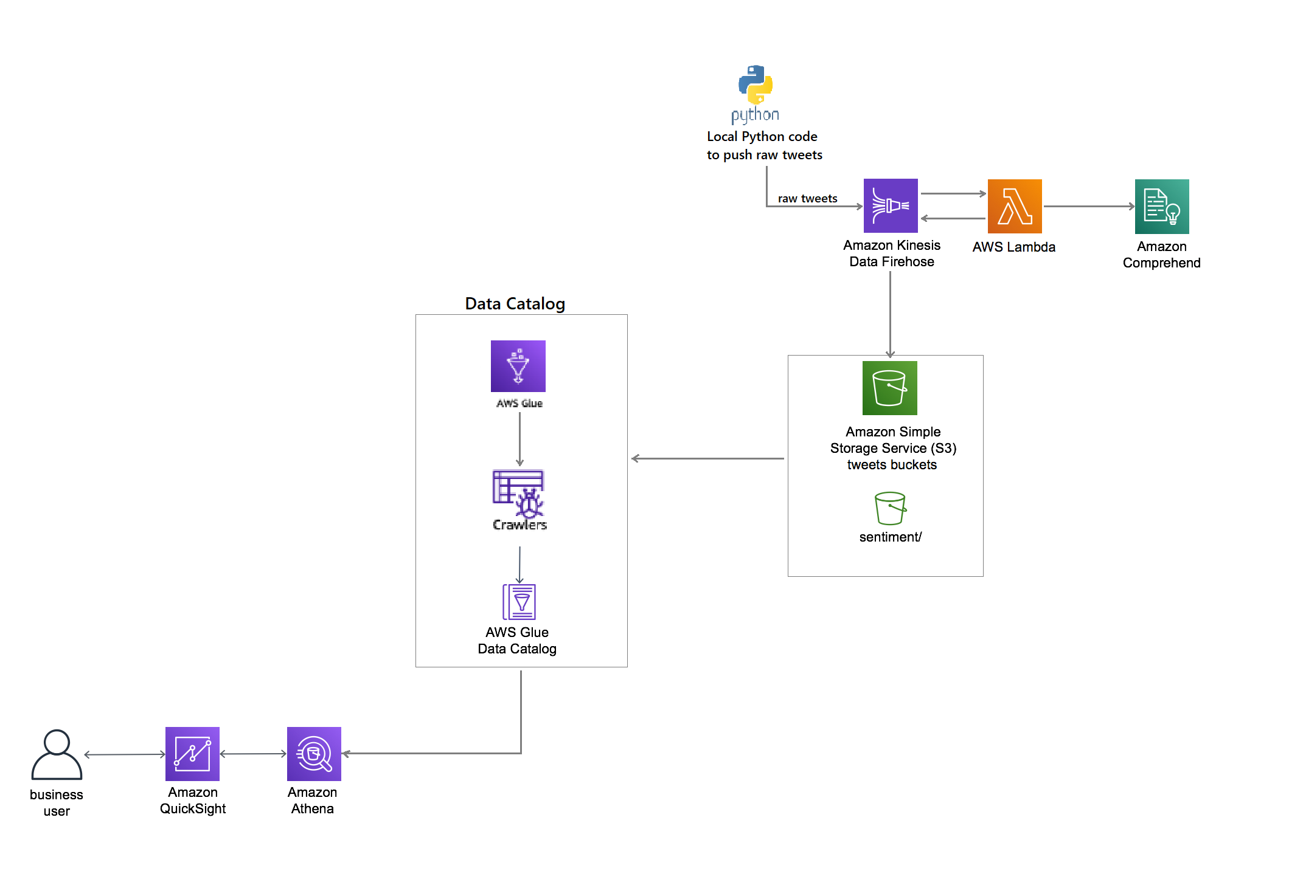
Architecture

Slide 3
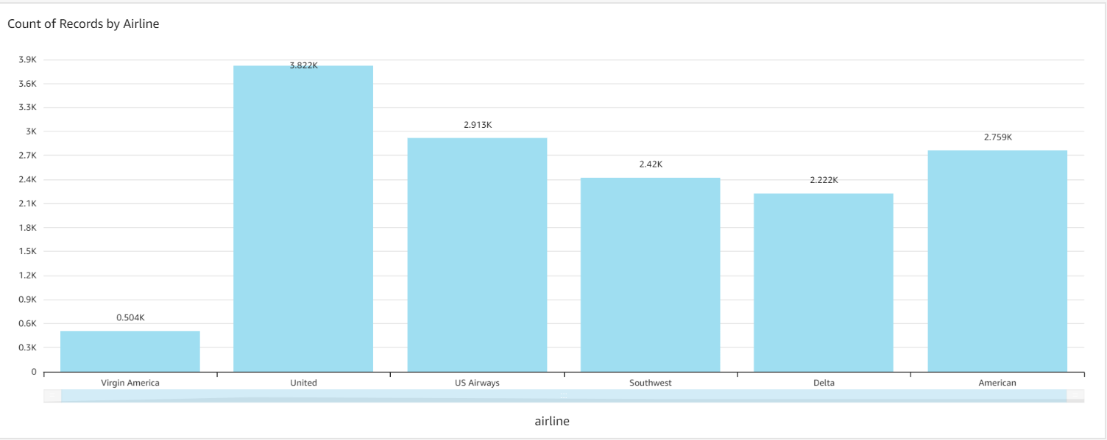

Slide 4
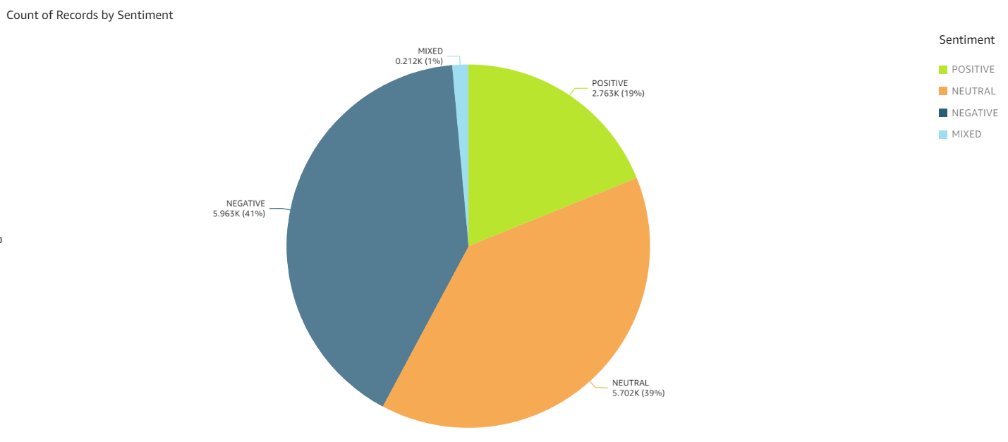

Slide 5


Slide 6
